Slide 1

Basic Details of the Team and Problem Statement
Ministry/Organization Name/Student Innovation: Ministry of Coal
PS Code: 1312
Problem Statement Title: Chatbot to respond to text queries pertaining to various Acts, Rules, and Regulations applicable to Mining industries
Team Name: RubriTronix
Team Leader Name: Manan Garg
Institute Code (AISHE): U-0522 Institute Name: Jaypee Institute of Information Technology, Noida
Theme Name: Smart Automation

Slide 2
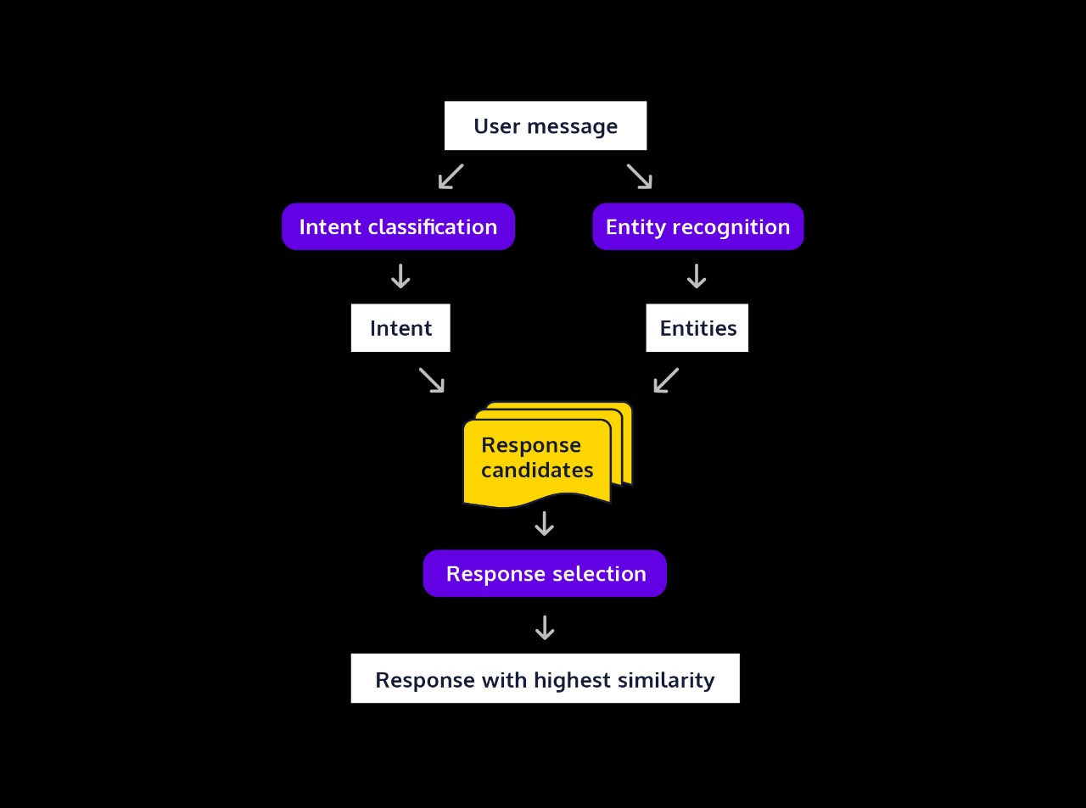
Idea/Approach Details
Describe your idea/Solution/Prototype here:
A Chatbot with an understanding of various Acts, Rules and Regulations, DGMS Circulars, CoI Proceedings, etc. that are applicable to Mining industries.
The Chatbot can address land-related queries by fetching information from government agencies and provide adequate assistance to the user regarding the application of the various Acts and Rules.
Describe your Technology stack here:
Natural Language Processing (NLP) Framework
Database
User Interface (UI)
Artificial Intelligence and Machine Learning

Slide 3
Idea/Approach Details
Describe your Use Cases here
Describe your Dependencies / Show stopper here
Provide guidance on health and safety regulations, best practices, and protocols to ensure the well-being of mining personnel and compliance with safety laws.
Provide information on land rights, acquisition procedures, and land use regulations to help users navigate these complexities.
Access specific sections of mining acts and rules, making it easier to extract data for studies and reports.
Offer general information about legal matters in the mining industry and direct users to legal professionals for more specific guidance.
Insensitive or incomplete information provided by user.
Legal advice request on matters that are not bound by the law as of yet.
If the information is too complex, it can provide link to read relevant legal documents online.

Slide 4
Team Member Details
Team Leader Name: Manan Garg
Branch (Btech/Mtech/PhD etc): Btech Stream (ECE, CSE etc): CSE Year (I,II,III,IV): II
Team Member 1 Name: Prateek Gupta
Branch (Btech/Mtech/PhD etc): Btech Stream (ECE, CSE etc): CSE Year (I,II,III,IV): II
Team Member 2 Name: Krishna Deol
Branch (Btech/Mtech/PhD etc): Btech Stream (ECE, CSE etc): CSE Year (I,II,III,IV): II
Team Member 3 Name: Medha Saxena
Branch (Btech/Mtech/PhD etc): Btech Stream (ECE, CSE etc): ECE Year (I,II,III,IV): II
Team Member 4 Name: Nanda Sai
Branch (Btech/Mtech/PhD etc): Btech Stream (ECE, CSE etc): CSE Year (I,II,III,IV): II
Team Member 5 Name: Prashast Srivastava
Branch (Btech/Mtech/PhD etc): Btech Stream (ECE, CSE etc): CSE Year (I,II,III,IV): II
Team Mentor 1 Name: Type Your Name Here
Category (Academic/Industry): Expertise (AI/ML/Blockchain etc): Domain Experience (in years):
Team Mentor 2 Name: Type Your Name Here
Category (Academic/Industry): Expertise (AI/ML/Blockchain etc): Domain Experience (in years):

